Slide 1
Intro to Winforms
Adding GUI Interfaces to PowerShell Projects

Slide 2

Agenda
Make a windows form
Add controls to a form
Label
Textbox
Combo Box
Button
Rich Text Box
Code an event

Slide 3
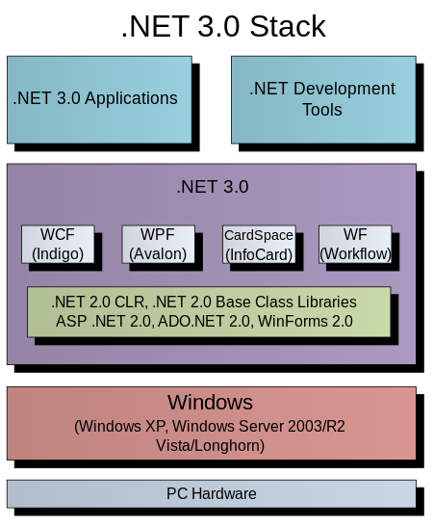
winforms
An assembly that we can call from PS and other .NET apps/tools
Winforms provide a GUI interface for I/O
We can code WinForms using command line or via 3rd party tools

Slide 4
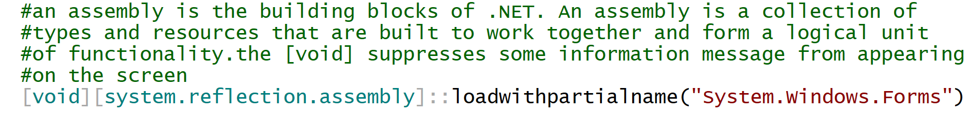
The form object
Forms contain all of our controls
It is the parent object
Process of coding a form:
We must add this line of code first to our PS script:
Then we make a new form object and set its properties

Slide 5
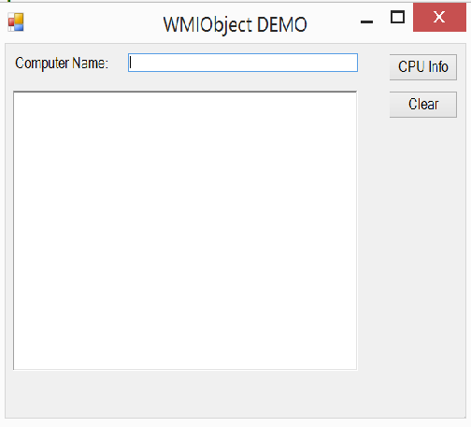
Common form properties
Start position relative to the client window
Form text
Min/Max settings
Background color
Font settings
Scroll bars/form resizing etc

Slide 6
Demo of creating a form
In this demo, we will set the form as follows:
It will appear at the center position of the client’s screen
It’s text (caption) will read as follows: WMIObject Demo
We will remove the min/max buttons

Slide 7
Adding controls to a form
Like forms, each control object needs to be created first
Then you set its properties
Location
Size
Text
[items that belong to it, like dropdown list items)
Once the control is defined, you add it to the form object container

Slide 8
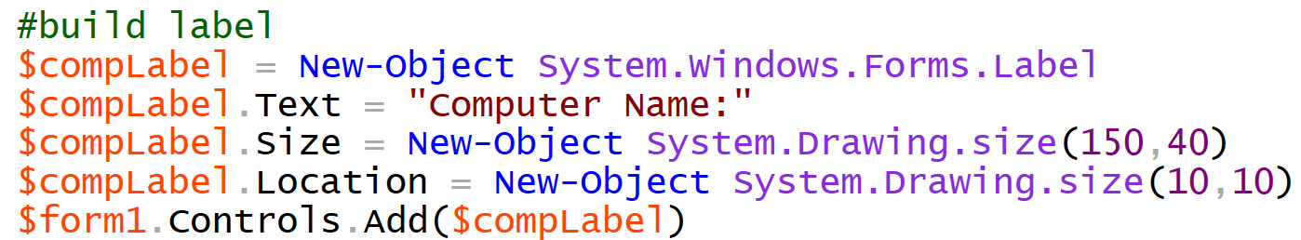
A few notes on control properties
Size and location properties are part of the drawing assembly
Size uses width, height values
Location uses x,y coordinates, where x is a horizontal axis in pixels and y is the vertical axis in pixlels
W , H
X, Y

Slide 9
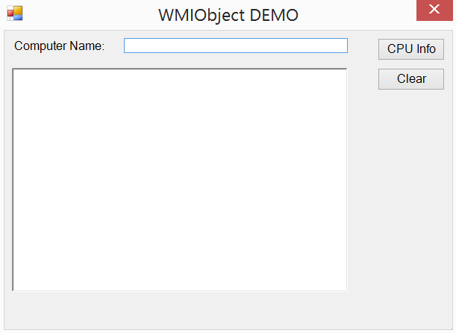
10px 160px 500px
10px
10px 500px
50px
DEMO OF X,Y COORDINATES FOR LOCATION PROPERTIES
RED = X AXIS
BLUE = Y AXIS

Slide 10
Adding events to a control
An event is something that happens to a control – often it is user-driven
Click or double-click
Mouseover/hover
Key-up, key-down
Close …
We can assign an event handler to a control, which means that when the event happens to the control, our code will execute
DEMO 1: assigning a function to the click event of the clear button
DEMO 2: assigning the click event to the CPU Info button

Slide 11
One More Example
In the next example, we will gather 2 values from the user
You will see a new control that holds many values
Combo box

Slide 12
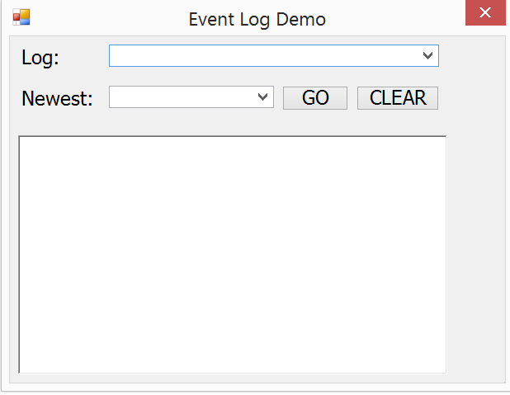
10px
10px 120px
60px
10px 120px 330px 420px
120px
DEMO OF X,Y COORDINATES FOR LOCATION PROPERTIES
RED = X AXIS
BLUE = Y AXIS

